Slide 1
I-Focus
Group 10-11 Samuel Leong 4S1(17)
Ryan Tan 4S1(21)
Walter Kong 4O3(33)
Songyuan 4S2(20)
Notes:
[ REQUIRES SANSATION AND MUSEO FONT ]
Good morning judges and fellow students. I am Samuel, this is …
And today I am very pleased to present to you our Cat 10 project… I-Focus.

Slide 2
Introduction
Notes:
I-Focus is a project that could possibly change the way we interact with our devices.

Slide 3
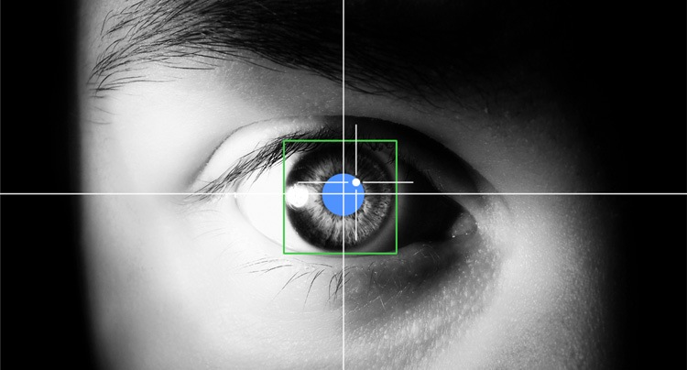
EFFICIENT.
Effective.
INTUITIVE.
Eye-tracking: Look at where you want the cursor to move.
Multi-modal Input: Eye-tracking + Clicks + Head gestures
Notes:
We are embarking on I-Focus - an EYE-tracking project. Eye-tracking is moving the cursor to where you are looking at. Our project combines eye-tracking with many other forms of input, such as head gestures and clicks, making it multimodal. I-Focus will use the latest eye-tracking technology and hopefully multi-modal input in order to create an efficient, effective and intuitive interface.

Slide 4


Objectives
DSO
Notes:
I-Focus aims to explore, through research with the Defence Science Organisation of Singapore, the most suitable input modes and their accompanying gestures.
This research, of course, will go hand in hand with applications and we will be creating a website along with a host games to be used as a tool to prove that our combination of gestures and input modes can be used by people for efficient, effective and intuitive interface control.

Slide 5

Target Audience
Physically Disabled
General Public
Notes:
And so… our project is aimed particularly at the physically disabled, as they would find our project the most useful. However, our project is likewise perfect for able-bodied individuals like you and I because our project focuses on developing an intuitive interface that combines a host of input technologies

Slide 6

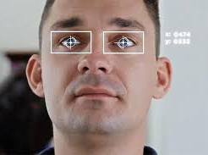
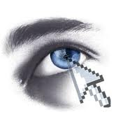
Why I-Focus?
Notes:
[shorten if possible]
So this leads us to answer the question – why I-Focus? Why do we need a revamp in the current forms of mouse and even touchscreen inputs for able-bodied people?
…
3 words: efficiency, effectiveness and intuitiveness
The one-size-fits-all model of kinesthetic input which we get from the mouse is simply inefficient and unintuitive. We use the mouse for everything – clicking, moving, dragging.. And the only reason why we find the mouse pretty effective and efficient is because we have been using it for a long time. [projector screen example] With eye-tracking, everything is fast, efficient and convenient. Just look at where you want to move and click. Look at a link, click on it. Look at an icon, open the application. Efficient. Effective. Intuitive.

Slide 7
Final Products

Slide 8

The Device
EyeTribe Eye-tracker
Affordable
Accurate
Notes:
The device we would be using is the EyeTribe eye-tracker, which is affordable and a lot more accurate than webcams. So we already have the device.. Our challenge is to..

Slide 9
Interface Control
Eye-tracking technologies
Multi-modal Input
Efficient.
Effective.
Intuitive.
Notes:
Combine eye-tracking technologies with other input methods which include head gestures, touches, and clicks, to create a better experience interacting with our daily devices.
But at the end of the day, we would be using mainly eye gestures to create an [click] efficient, effective, and intuitive interface.

Slide 10



Programming Languages
HTML 5
CSS 3
JavaScript
#
Notes:
Read off le slides:
HTML
CSS
JavaScript
Flash
C#

Slide 11



The Applications
Notes:
Our final products will demonstrate the efficiency of eye tracking on applications, websites, and simple games.

Slide 12

The Applications
Cursor Movement
Eye-tracking
Clicks
Kinesthetic
Head gestures
Notes:
We will develop an application so that users can use eye-tracking and our set of gestures on their computers. Eye movements will allow the user to navigate around the screen, just like a cursor, while clicks will be kinesthetic, performed through physical buttons. For the physically disabled, other options for clicks will be made available.

Slide 13
The Applications
Head Swipes
Navigaton
Eye gestures
Activate content
Pan
Automatic Scrolling
Notes:
Our interface will be in the form of a website that uses as little clicks as possible and requires the coordination of eye and head gestures to control. In the website, we will feature functions such as those you see on the screen.

Slide 14
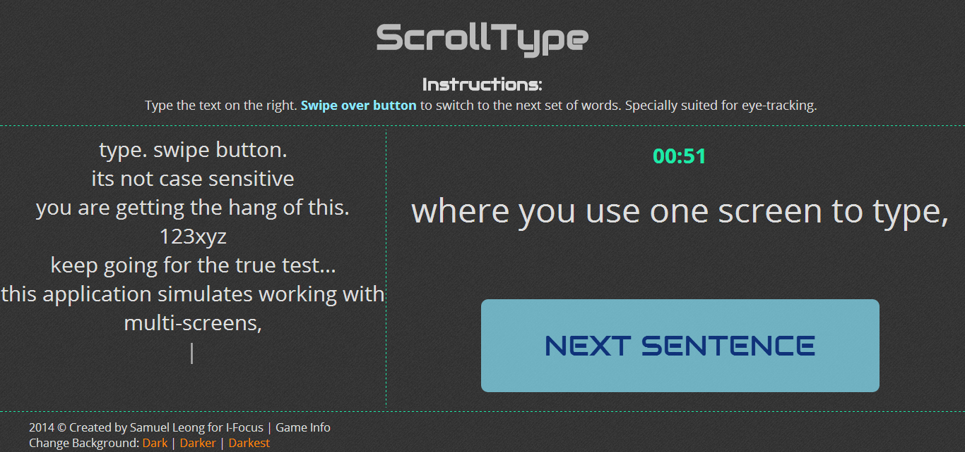
The Applications
Notes:
The website we are creating will host our self-made games to best exhibit the advantages of our multimodal approach. On the right is an example of a game that helps users to type without lifting their hands from the screen.

Slide 15
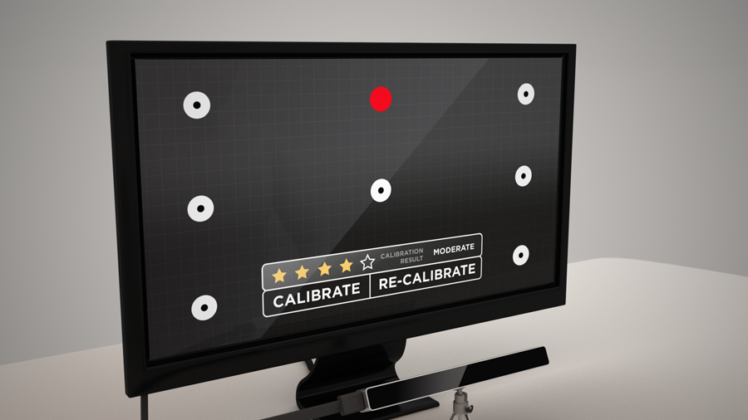
Sneek Peek

Slide 16
Sneek Peek

Slide 17
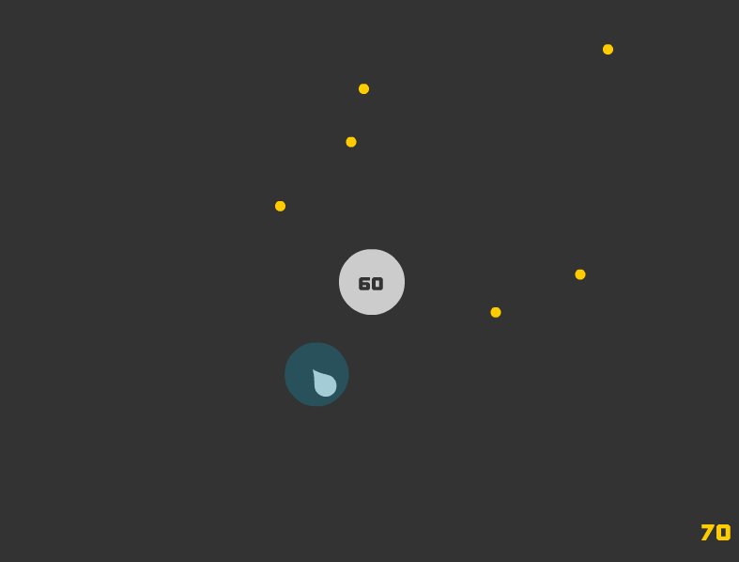
Sneek Peek

Slide 18
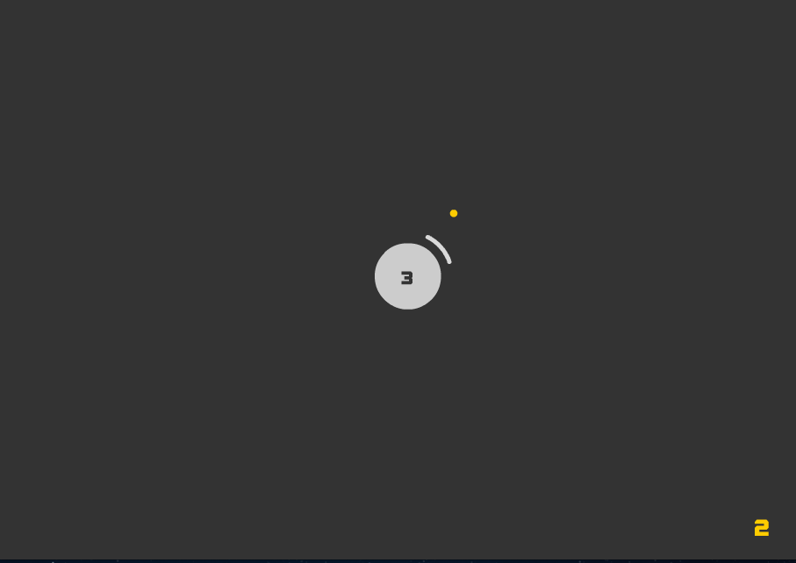
Sneek Peek

Slide 19
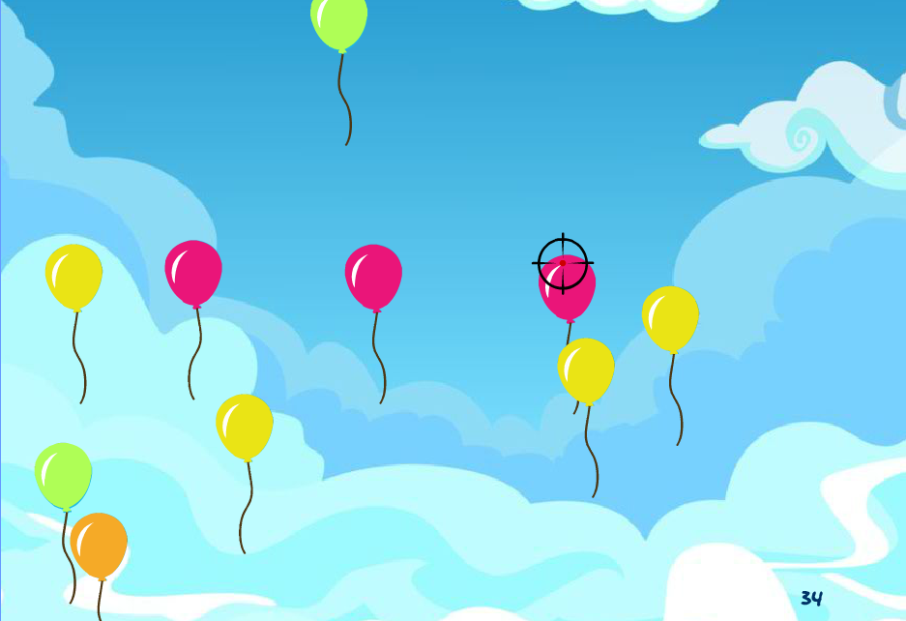
Sneek Peek

Slide 20


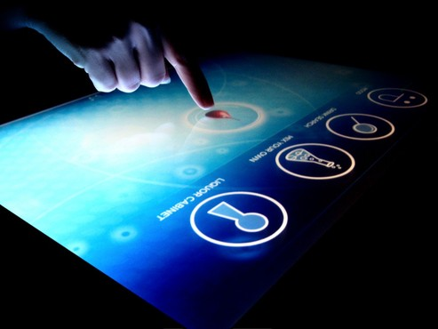
Originality
One-size fits all? Not quite.
Notes:
The most common forms of human computer interaction is with the mouse and keyboard, or with touchscreen and hand gestures. These are single modes of kinesthetic input that offer a one-size-fits-all approach.

Slide 21
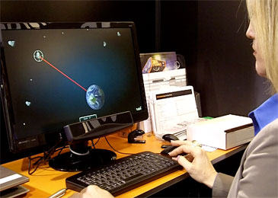
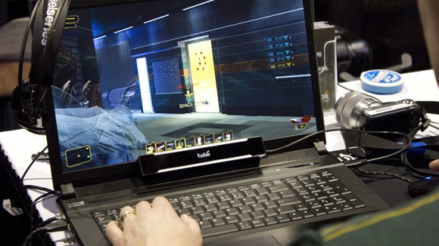
Originality
Efficient. Effective. Intuitive.
Notes:
Our project aims for a more efficient and intuitive multimodal input on a case-by-case basis, and we are the first to be exploring this line of research.

Slide 22
Methodology

Slide 23
Methodology
Research
Experiment
Production
Notes:
[shorten]
We will first explore current technology, to prevent re-inventing the wheel.
With a vast knowledge of the possible permutations and limitations, we can then experiment with variations.
After discovering the optimal interface control, we will then move on to designing the final application.

Slide 24
Partners
Defence Science Organisation of Singapore
External Mentors
Research
Notes:
We will be cooperating with external mentors from the Defense Science Organization of Singapore (DSO) for our research.

Slide 25
Timeline
Prelim Presentation
Semis Presentation
Finals Presentation
Prelim
Semis
Finals
Planning
Developmental
Implementation
Alpha Testing
Beta Testing
Extensions
Notes:
This is our timeline for our project, which is broken down into the following phases.

Slide 26
Job Distribution
Samuel
Walter
Ryan
Songyuan
Programming
Design
Logo
Website
Art
Research
Publicity
Game Design
Console App
Website
Console App
Notes:
Our team will comprise of the programmers, designers and researchers.

Slide 27
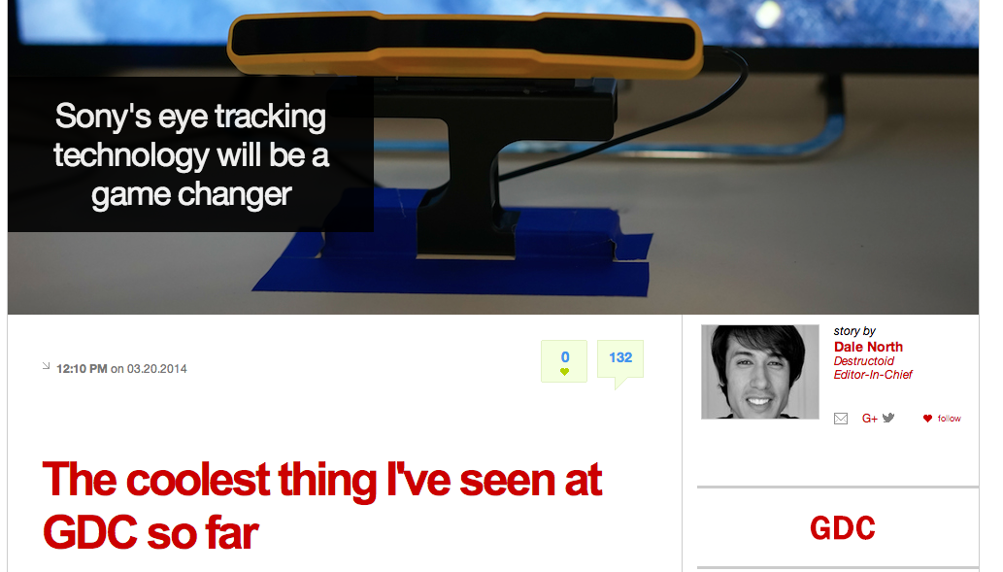
Sony Eye-tracking (Games)
20 March 2014
Notes:
This is an article about Sony’s eye-tracking technology.

Slide 28
Sony Eye-tracking (Games)
It only took a few seconds to get used to, and using the analog stick to compliment eye camera control became natural quickly.
I imagined that aiming and controlling the camera with my eyes would be tiring, but it felt completely natural. Just look and shoot.
http://www.destructoid.com/sony-s-eye-tracking-technology-will-be-a-game-changer-272225.phtml
Notes:
Which talks about how eye-tracking is responsive and makes gaming easier.

Slide 29
References
http://www.destructoid.com/sony-s-eye-tracking-technology-will-be-a-game-changer-272225.phtml

Slide 30
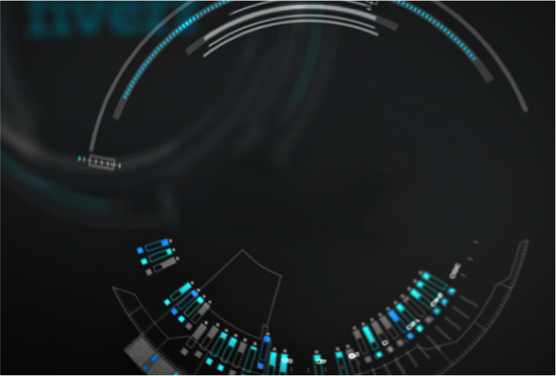
Thank You!

